Slide 1
Principles of Database Systems (CS307) Lecture 15: Advanced Topics
Ran Cheng
Department of Computer Science and Engineering
Southern University of Science and Technology
Most contents are from slides made by Stéphane Faroult and the authors of Database System Concepts (7th Edition).
Their original slides have been modified to adapt to the schedule of CS307 at SUSTech.
Notes:
In this chapter, I will introduce how to retrieve data from one table. Just from one table. I will introduce how to retrieve data from multiple table in next chapter.

Slide 2
Query Planning and Optimization

Slide 3
Basic Steps in Query Processing
Parsing and Translation
Optimization
Evaluation

Slide 4
Basic Steps in Query Processing
Parsing and Translation
Translate the query into its internal form
The internal form is then translated into relational algebra
Parser checks syntax and verifies relations

Slide 5
Basic Steps in Query Processing
Optimization
A relational algebra expression may have many equivalent expressions
E.g.,
σ_{salary<75000}(∏_{salary}(instructor))
is equivalent to
∏_{salary}(σ_{salary<75000}(instructor))
Really equaivalent?
But the number of rows involved in the projection operation may be (significantly) smaller in the second expression

Slide 6
Basic Steps in Query Processing
Optimization
A relational algebra expression may have many equivalent expressions
… and each relational algebra operation can be evaluated using one of several different algorithms
Correspondingly, a relational-algebra expression can be evaluated in many ways

Slide 7
Basic Steps in Query Processing
Optimization
Evaluation Plan: Annotated expression specifying detailed evaluation strategy
E.g.,:
Use an index on salary to find instructors with salary<75000
Or perform complete relation scan and discard instructors with salary<75000
Cost can be estimated using statistical information from the database catalog
E.g., Number of tuples in each relation, size of tuples, etc.
Query Optimization: Choose the one with the lowest cost among all equivalent evaluation plans

Slide 8
Basic Steps in Query Processing
Evaluation
The query-execution engine takes a query-evaluation plan, executes that plan, and returns the answers to the query

Slide 9
Further Reading
Database System Concepts , 7th Edition
Part Six
Chapter 15 “Query Processing”
Chapter 16 “Query Optimization”

Slide 10
Beyond Tables: More Data Types

Slide 11
Semi-Structured Data
Many applications require storage of complex data, whose schema changes often
The relational model’s requirement of atomic data types may be an overkill
E.g., storing set of interests as a set-valued attribute of a user profile may be simpler than normalizing it
Data exchange can benefit greatly from semi-structured data
Exchange can be between applications, or between back-end and front-end of an application
Web-services are widely used today, with complex data fetched to the front-end and displayed using a mobile app or JavaScript
JSON and XML are widely used semi-structured data models

Slide 12
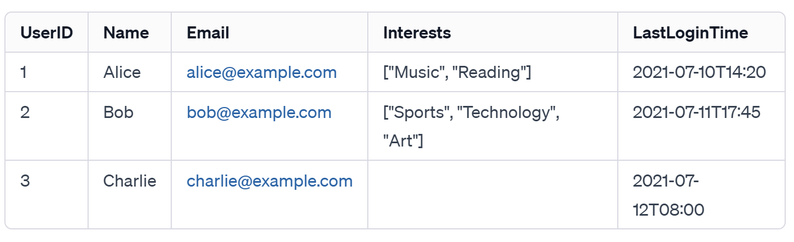
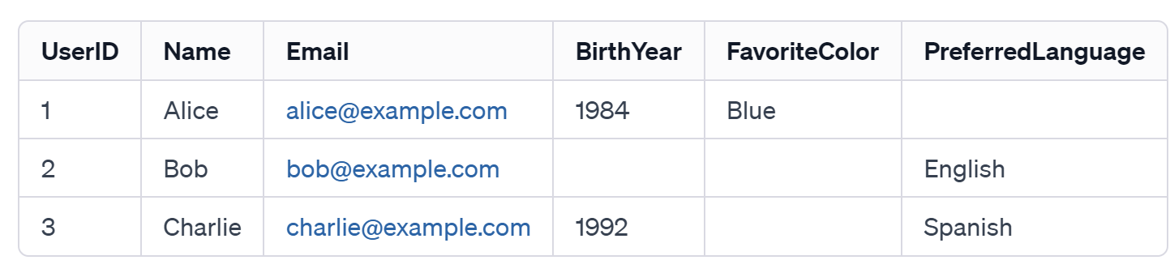
Features of Semi-Structured Data Models
Flexible schema
Wide column representation: allow each tuple to have a different set of attributes, can add new attributes at any time
Sparse column representation: schema has a fixed but large set of attributes, by each tuple may store only a subset

Slide 13
Features of Semi-Structured Data Models
Multivalued data types
Sets, multisets
E.g.,: set of interests: {"basketball", "cooking", "anime", "jazz"}
Key-value map (or just map for short)
Store a set of key-value pairs
E.g.,
{(brand, Apple), (ID, MacBook Air), (size, 13), (color, silver)}
Operations on maps
put(key, value)
get(key)
delete(key)

Slide 14
Features of Semi-Structured Data Models
Arrays
Widely used for scientific and monitoring applications
E.g., readings taken at regular intervals can be represented as array of values instead of (time, value) pairs
[5, 8, 9, 11] instead of {(1,5), (2, 8), (3, 9), (4, 11)}
Array database: a database that provides specialized support for arrays
E.g., compressed storage, query language extensions, etc.
Oracle GeoRaster, PostGIS, SciDB, etc

Slide 15
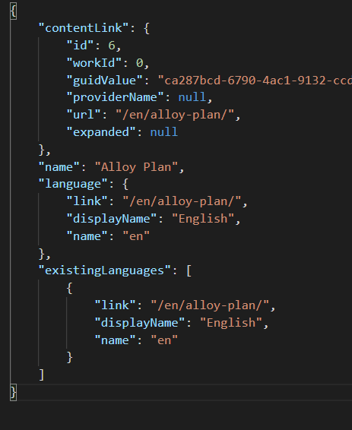
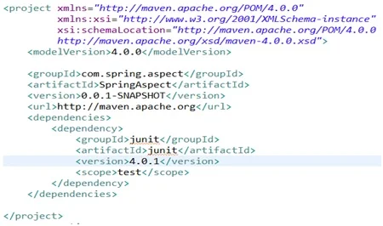
Nested Data Types
Hierarchical data is common in many applications
JSON (JavaScript Object Notation)
Widely used today
XML (eXtensible Markup Language)
Earlier generation notation, still used extensively

Slide 16
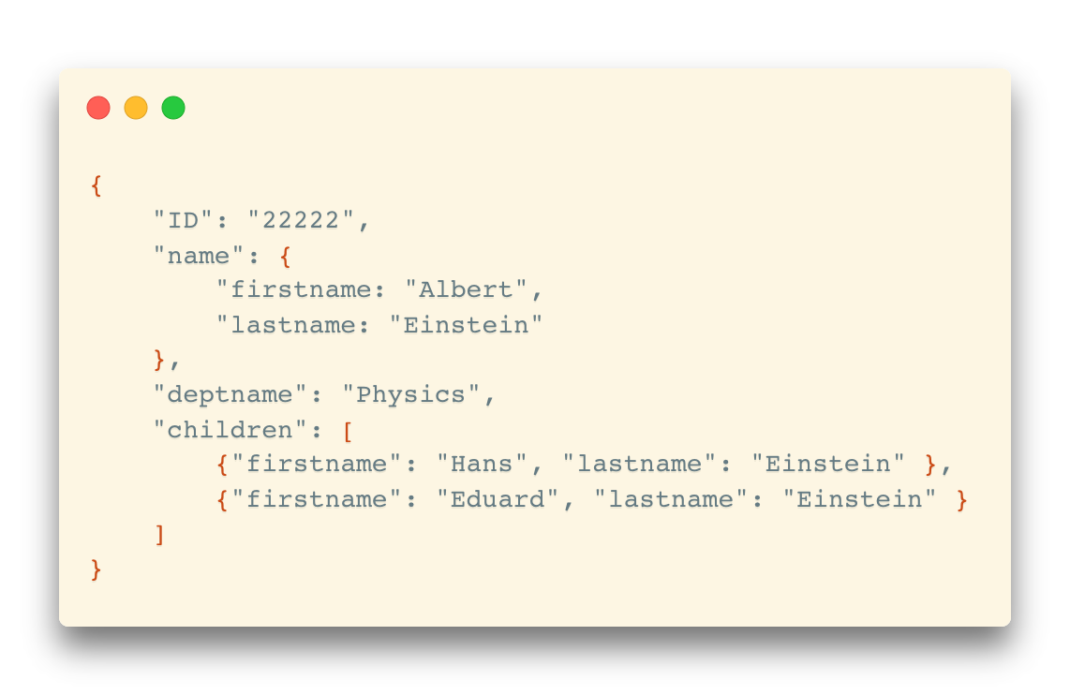
JSON
Textual representation widely used for data exchange
Types: integer, real, string, and
Objects: key-value maps, i.e. sets of (attribute name, value) pairs
Arrays: also key-value maps (from offset to value)

Slide 17
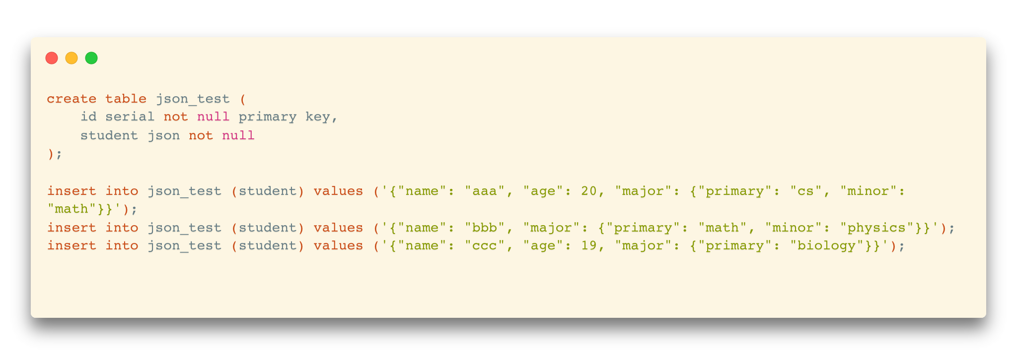
JSON
JSON is ubiquitous in data exchange today
Widely used for web services
Most modern applications are architected around on web services
PostgreSQL supports JSON format columns

Slide 18
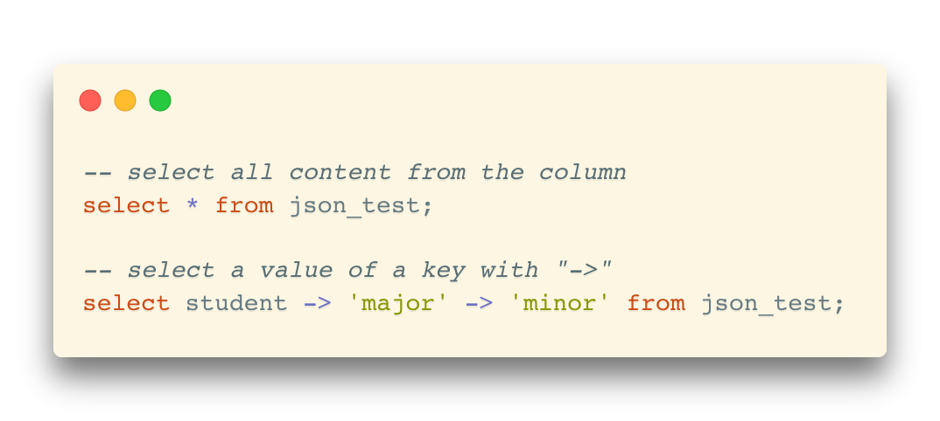
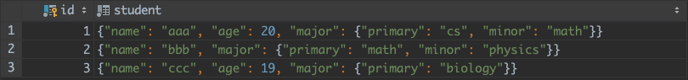
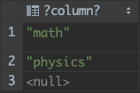
JSON
JSON is ubiquitous in data exchange today
Widely used for web services
Most modern applications are architected around on web services
PostgreSQL supports JSON format columns

Slide 19
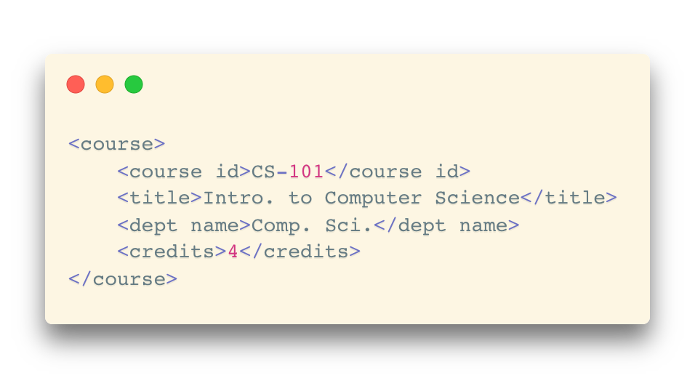
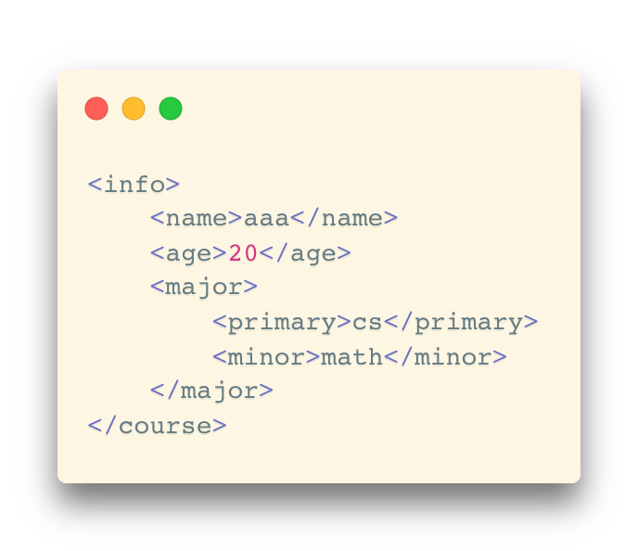
XML
XML uses tags to mark up text
Tags make the data self-documenting
Tags can be hierarchical

Slide 20
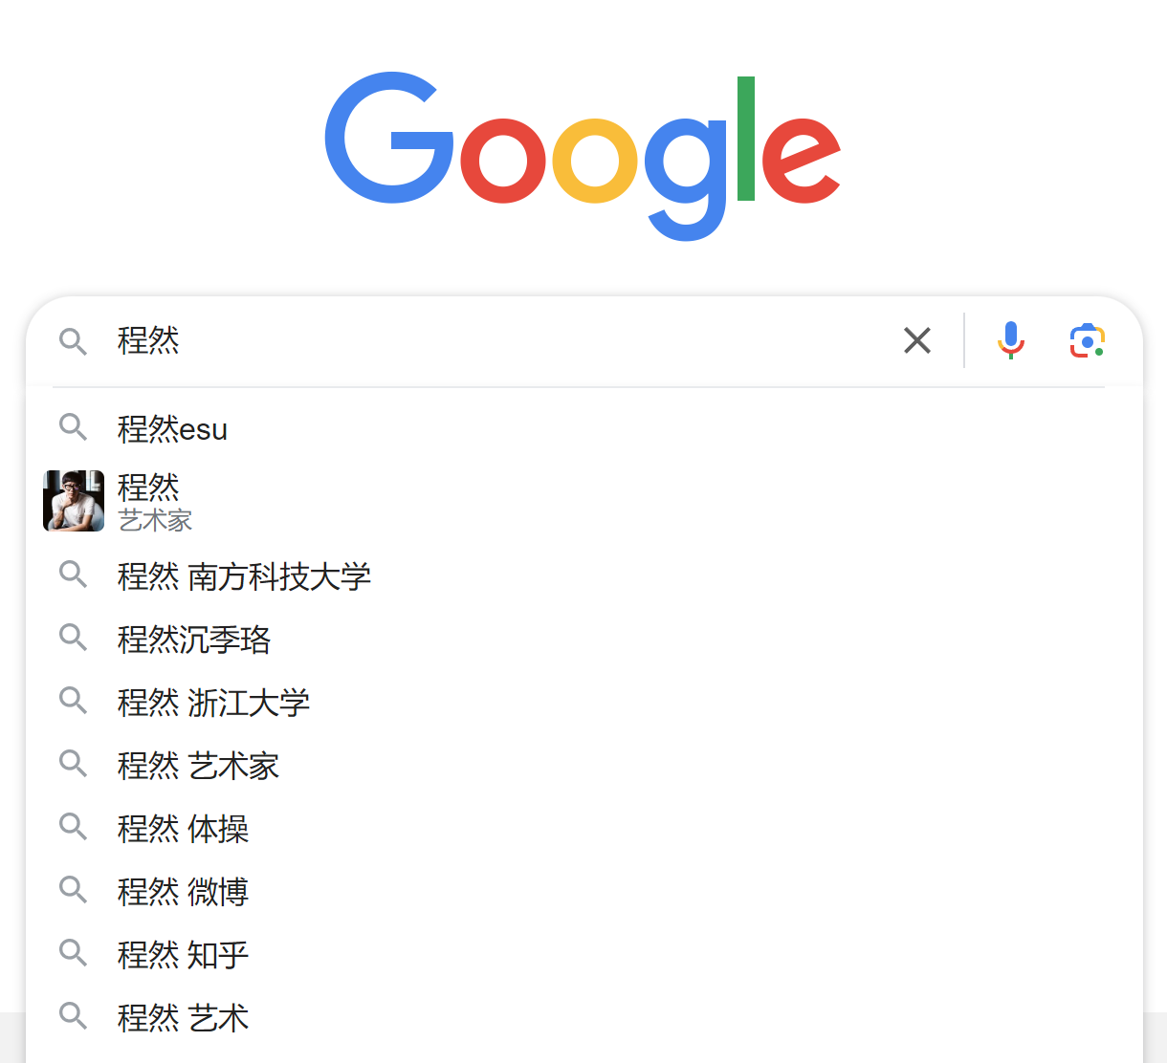
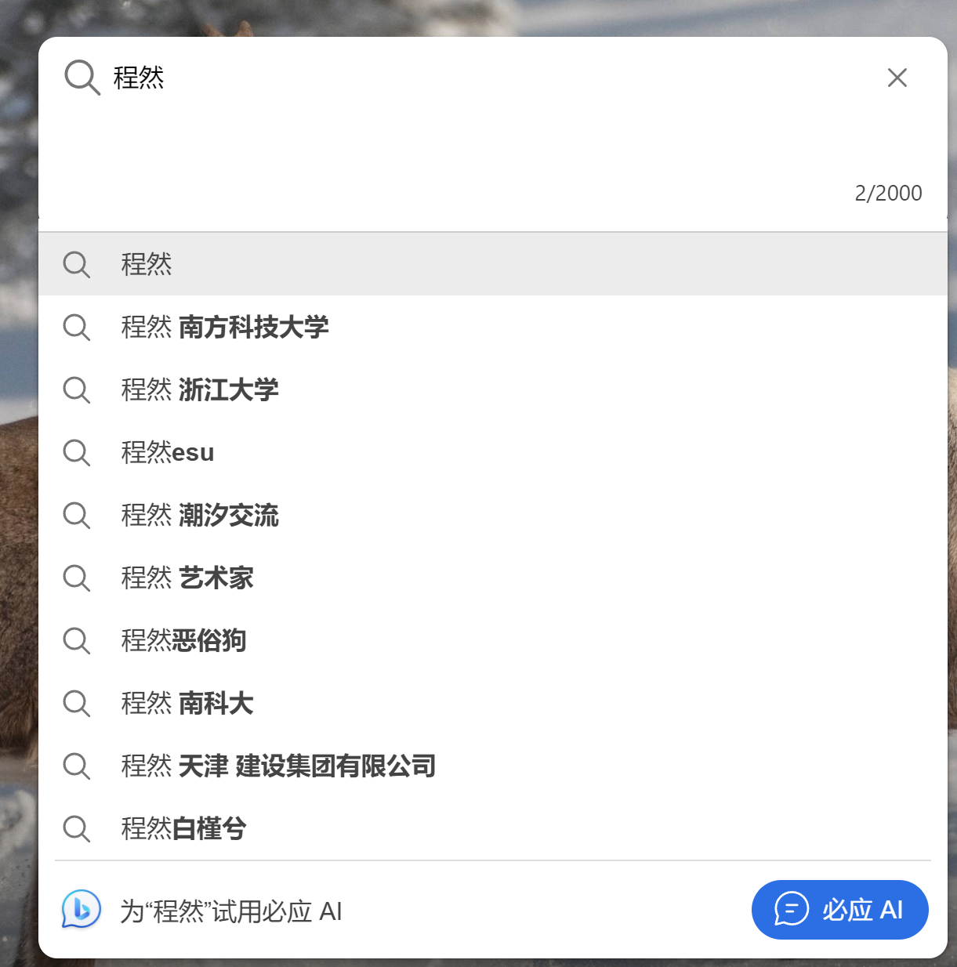
Textual Data
Information retrieval: querying of unstructured data
Simple model of keyword-based queries
Given query keywords, retrieve documents containing all the keywords
More advanced models rank relevance of documents
Relevance ranking (e.g. 搜索引擎)
Apart from keywords, we need to consider:
Frequency of keywords within the documents.
Recency of the documents.
User interaction metrics (e.g., click-through rate).
…

Slide 21
Spatial Data
Spatial databases store information related to spatial locations, and support efficient storage, indexing and querying of spatial data.
Geographic data: road maps, land-usage maps, topographic elevation maps, political maps showing boundaries, land-ownership maps, and so on.
Geographic information systems (GIS) are special-purpose databases tailored for storing geographic data.
Round-earth coordinate system may be used
(latitude 纬度, longitude 经度, elevation 海拔)
Geometric data: design information about how objects are constructed
E.g., designs of buildings, aircraft, layouts of integrated-circuits.
2 or 3 dimensional Euclidean space with (X, Y, Z) coordinates

Slide 22
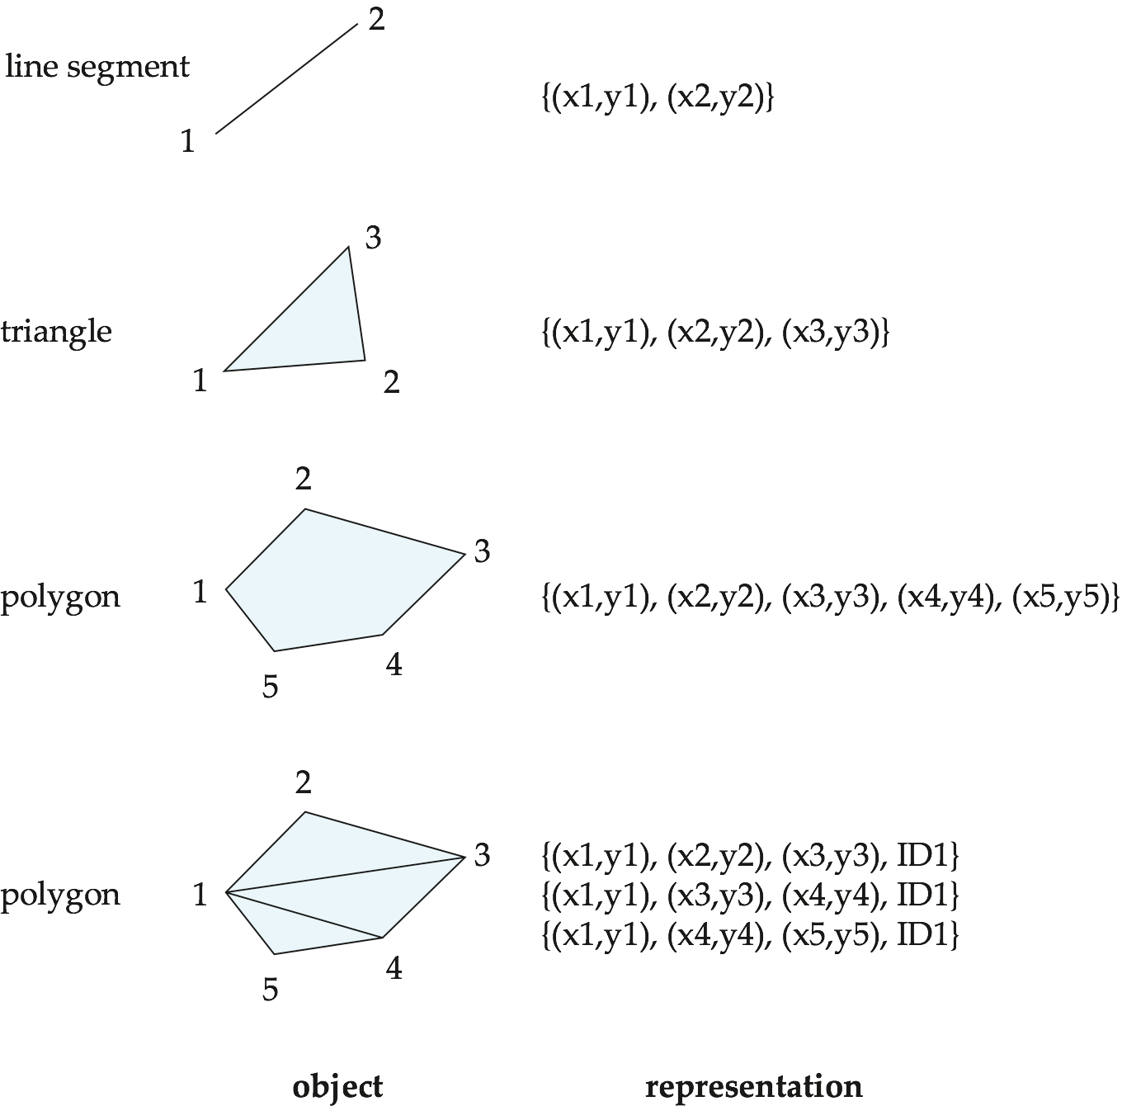
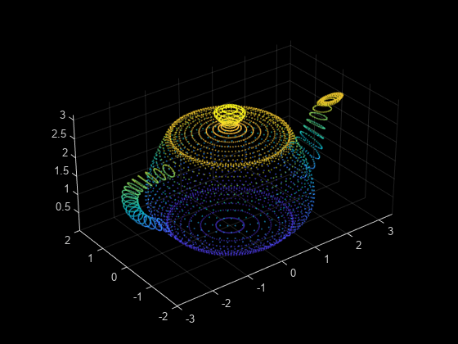
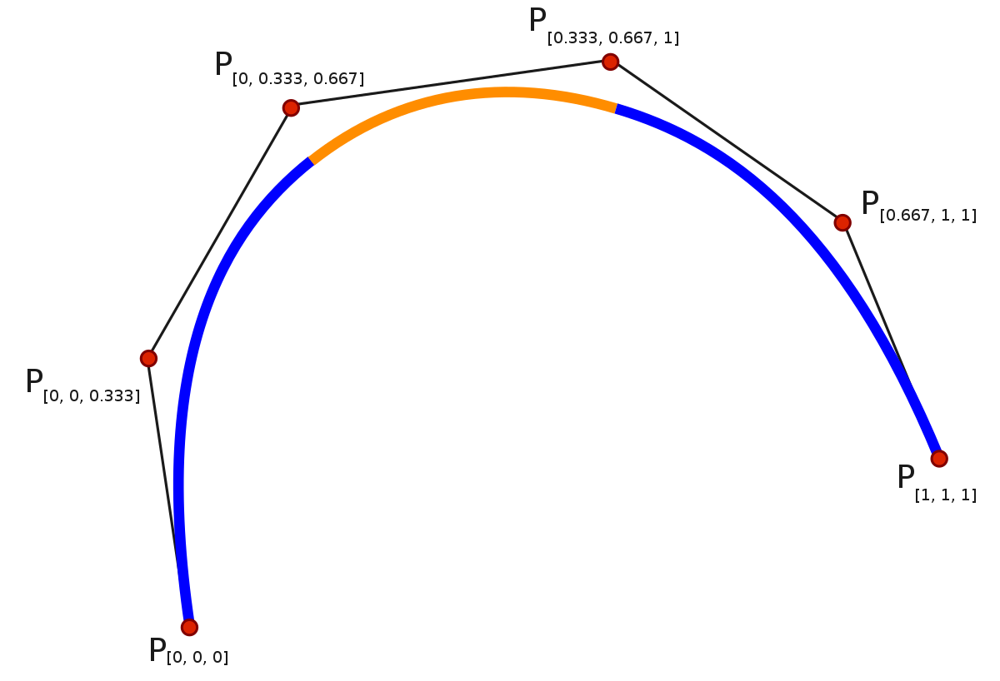
Representation of Geometric Information
Various geometric constructs can be represented in a database in a normalized fashion
Point cloud
B splines

Slide 23
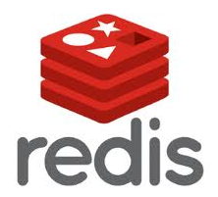



NoSQL Database
“Not Only SQL”
Useful when working with a huge quantity of data when nature of data does not require a relational model
Usually not built on tables and queried by SQL
Examples
Document store – MongoDB
Graph structure – Neo4j
Key-value storage – Redis, LevelDB
Tabular – Apache Hbase (Hadoop-based)

Slide 24
Beyond PostgreSQL: More DBMS

Slide 25
Commercial & Open-Source Solutions
Commercial Relational DBMS:
Oracle Database
Microsoft SQL Server
IBM DB2
…
Open-Source Counterparts:
MySQL (MariaDB)
PostgreSQL
…

Slide 26
Commercial & Open-Source Solutions
Factors to consider open-source databases
Cost
Open-source databases are generally free
Customizability
Add your own features in the source code
Community support
Documentations, bug fixes, discussions

Slide 27
Commercial & Open-Source Solutions
Factors to consider commercial databases
Technical support
Guaranteed professional services
Usability
Generally easier to deploy and use
Can be seamlessly integrated into other commercial products
Feature support
Enterprise-level feature extension (More functions, useful SQL syntax, etc.)

Slide 28
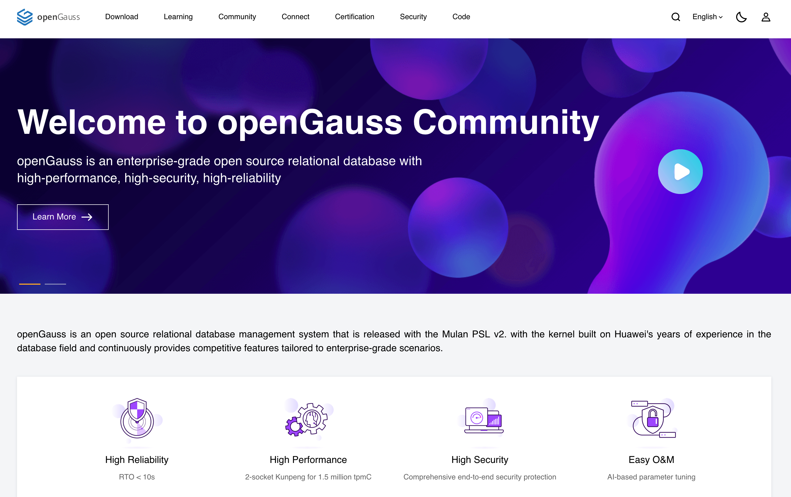
openGauss
Relational DBMS from Huawei
Enterprise-grade open-source relational database
Client-server architecture
High-performance, high-reliability, high-security
Community support
* Compatible to PostgreSQL clients
https://www.opengauss.org/en/

Slide 29
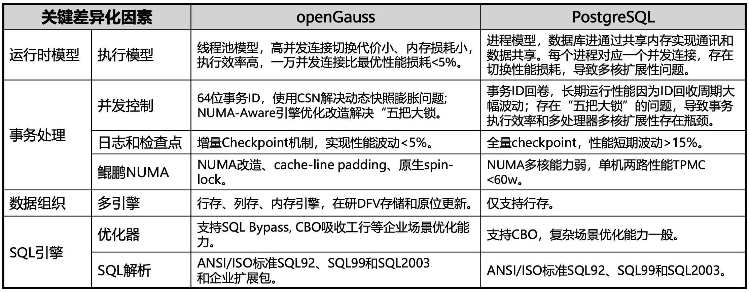
Key Differences between openGauss and PostgreSQL
originated from PostgreSQL-XC (eXtensible Cluster)
Fundamental differences in the architecture and key technologies, especially in the storage engine and query optimizer

Slide 30
Key Differences between openGauss and PostgreSQL
originated from PostgreSQL-XC (eXtensible Cluster)
Fundamental differences in the architecture and key technologies, especially in the storage engine and query optimizer
 | openGauss | PostgreSQL
Execution Model | Thread pool-based (higher concurrency performance) | Process-based
Data Organization | Multiple engines: Row-oriented, column-oriented, in-memory storage | Only row-oriented
SQL Optimization | More complex enterprise-level optimization | Cost-based optimization
SQL Parsing | ANSI/ISO SQL92, SQL99, SQL2003 w/ enterprise-level extensions | ANSI/ISO SQL92, SQL99, SQL2003

Slide 31
Beyond Storage: Data Analytics

Slide 32
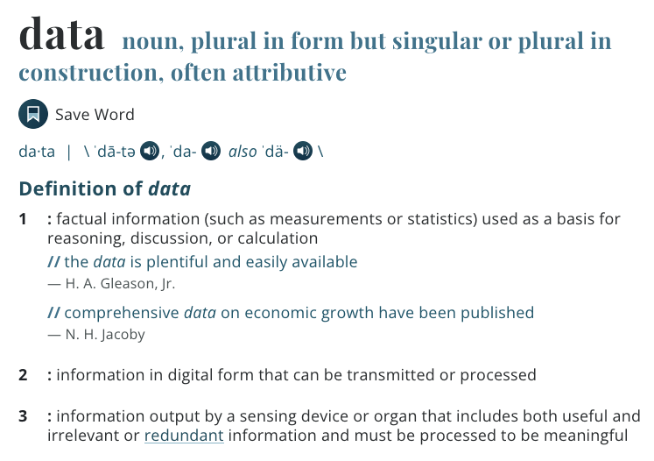
What is Data (Revisited)
factual information (such as measurements or statistics) used as a basis for reasoning, discussion, or calculation
https://www.merriam-webster.com/dictionary/data

Slide 33
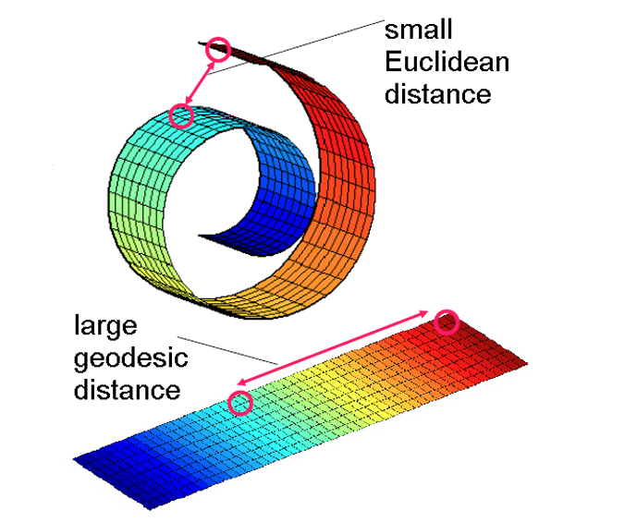
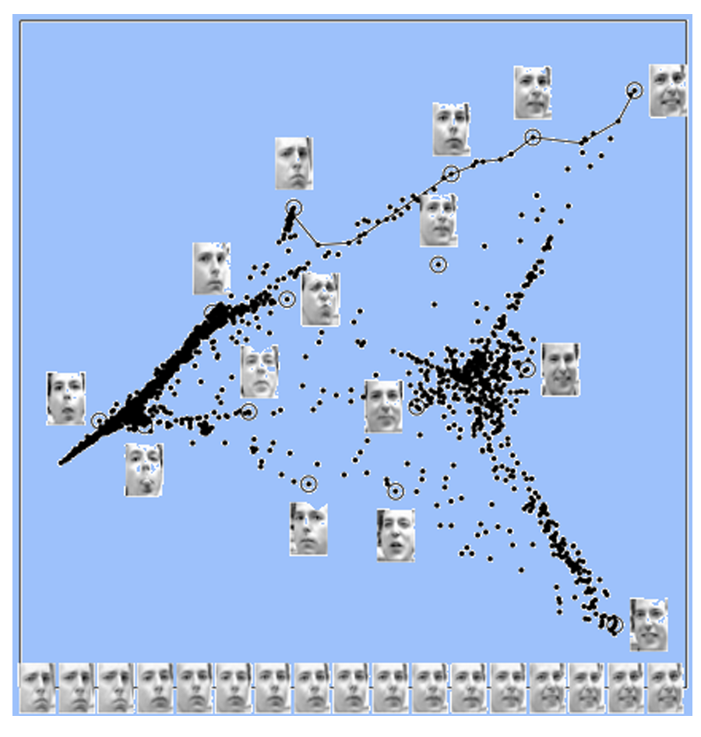
What you see is what you get?

Slide 34
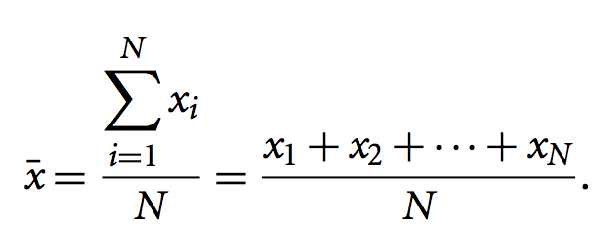
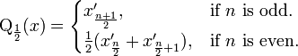
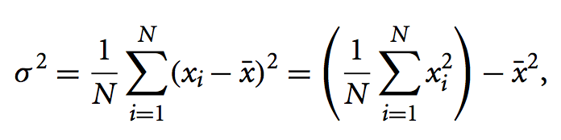
Basic Statistical Descriptions
Overall picture of your data
Basis of exploratory data analysis
Mean
Median
Variance

Slide 35
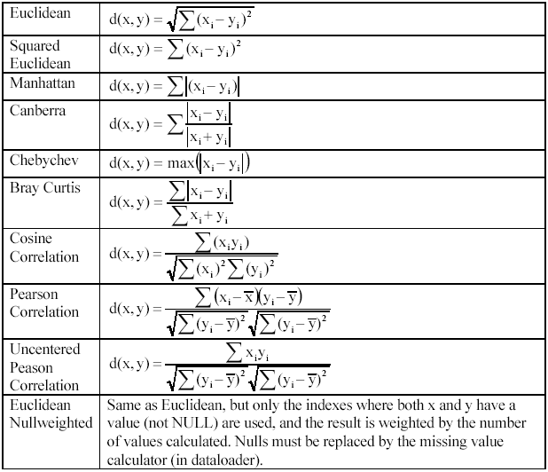
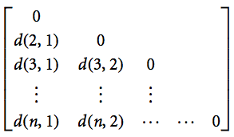
Relationship between Data Objects: Data (Dis)Similarity
Measurement of relationships
Commonly used in many statistical methods and data mining algorithms
Dissimilarity Matrix & Distance Measures

Slide 36
What is Big Data?
A collection of data sets so large and complex

Slide 37
Three Dimensions of Big Data
Volume
From GB to TB, PB, or higher
Velocity
Processing speed
Variety
Text, sensor data, multimedia, …
Other (new) aspects:
Veracity: Trustworthiness
Value: Worth of data

Slide 38
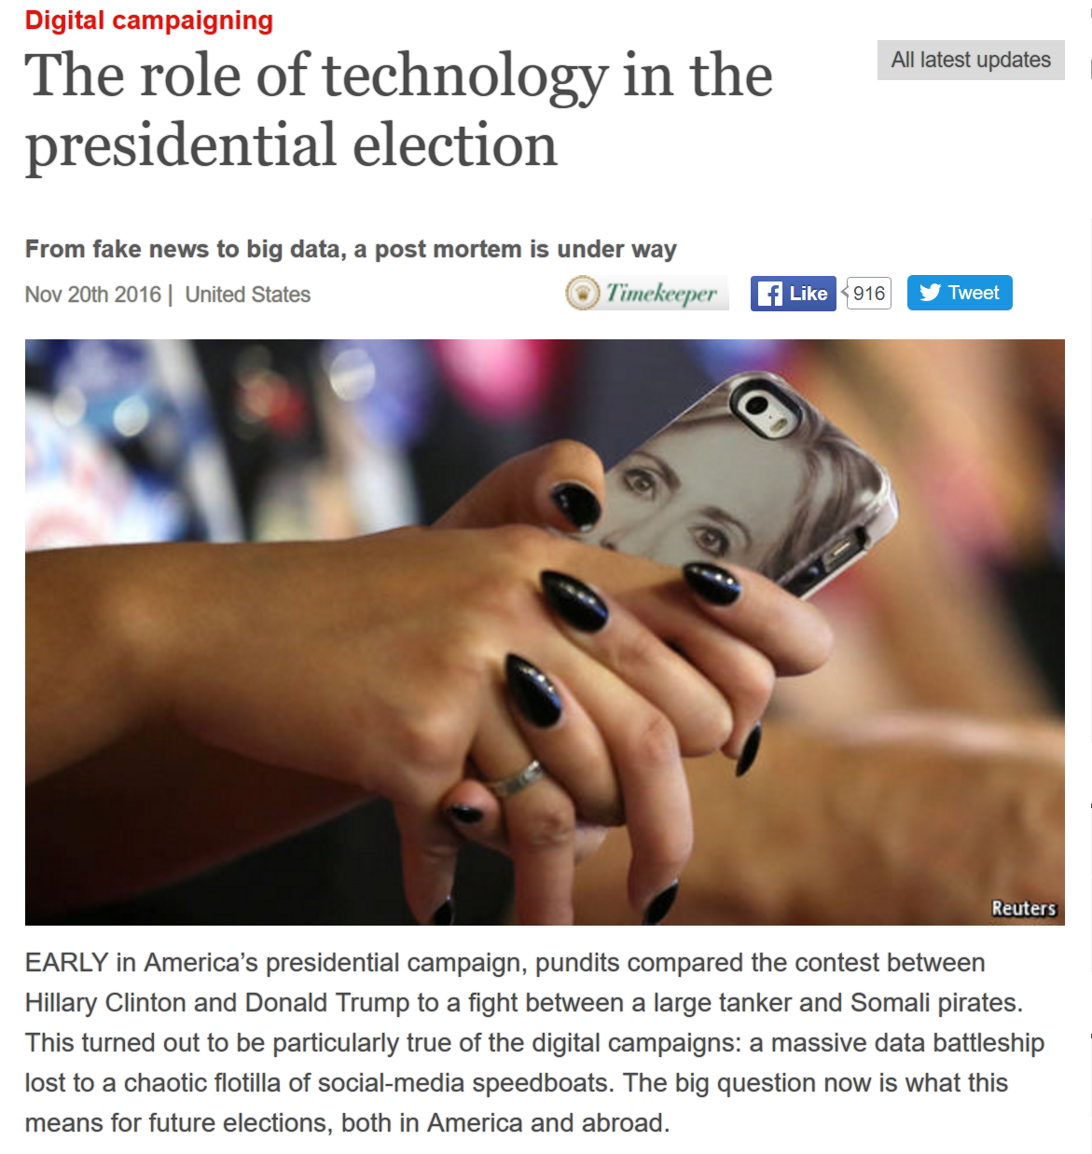
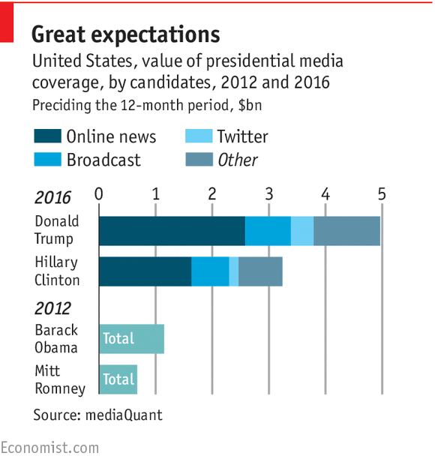
The Emergence of Data Science
2016: “Trump vs. Clinton: How Big Data and scientists helped Trump win the election”

Slide 39


Standard Architecture
Application
Database
Data Products
Data
Warehouse
ETL
(Extract, Transform, Load)
Business Intelligence
Analytics

Slide 40
Instantiations(1) - Businessmen
Data Sources
Web pages
Excel
Extract-Transform-Load (ETL)
Copy & paste
Data Warehouse
Excel
Business Intelligence & Analytics
Excel functions
Excel charts
Visualization tools: Power BI, Tableau
…

Slide 41
Instantiations(2) - Programmers
Data Sources
Web scraping, web services API
CSV files
Database queries
ETL
wget, curl, Beautiful Soup, lxml, …
Data Warehouse
Files
Business Intelligence & Analytics
Numpy, pandas, Matplotlib, R, Octave, …

Slide 42
Instantiations(3) - Enterprises
Data Sources
Application databases(Oracle, IBM, …)
Intranet files
Application log files
ETL
Infomatica, IBM DataStage, …
Data Warehouse
Teradata, Oracle, IBM DB2, …
Business Intelligence & Analytics
SAS, SPSS, R, …
Power BI, Tableau, Spotfire, …

Slide 43
Instantiations(4) – Web Companies
Data Sources
Application databases
Logs
Web crawl data
ETL
Apache Flume, Apache Sqoop, …
Data Warehouse
Hadoop-based: Hive, Hbase
Microsoft Azure, Amazon Redshift
Business Intelligence & Analytics
Argus, R, …

Slide 44
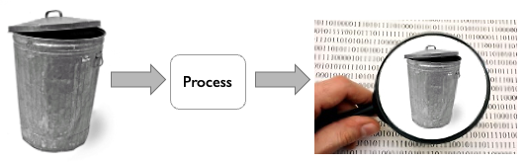
“Garbage in, garbage out.”
Raw data can always be DIRTY!

Slide 45

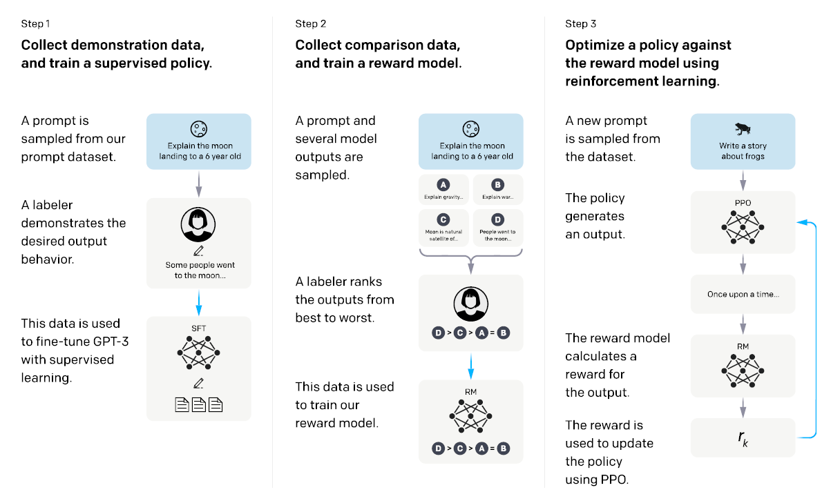
Data Quality
Data quality:
Accuracy
Completeness
Consistency
Interpretability
…

Slide 46
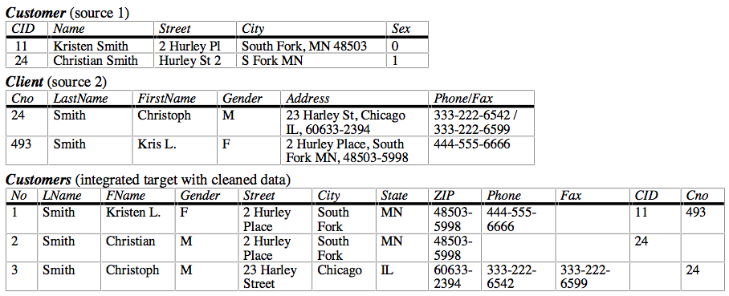
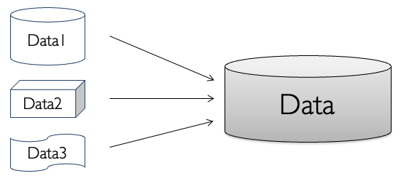
Data Integration
Data integration involves combining data residing in different sources and providing users with a unified view of these data.
Remember “views” in DBMS?
Management of data from multiple sources

Slide 47
Typical Data Cleaning and Integration Workflow
Data analysis
Detailed inspection before operations
Conflicts resolution
Resolve data confliction between data sources to be integrated
Definition of transformation workflow and mapping rules
Workflow methods for schema adaption and transformation
Verification of Workflow
Verify each steps
Transformation
start the process

Slide 48
Load and Store Data
File-based Storage
Simplest way & easy to manage
Scalability is low
Database & DBMS
What we have learned for 10+ weeks
Data Warehouse

Slide 49
Data Warehouse
A data warehouse is a subject-oriented, integrated, time-varient, and nonvolatile collection of data in support of management’s decision making process.
-- W. H. Inmon, “Building the Data Warehouse”. 1996.
Loosely Speaking, a data warehouse refers to a data repository that is maintained separately from an organization’s operational databases.
-- J. Han and M. Kamber, “Data Mining: Concepts and Techniques”, 3rd ed., 2011.

Slide 50
Differences between Databases and Data Warehouses
 | DB | DW
Characteristics | operational processing | informational processing
Orientation | transaction | analysis
User | terminal users: clerk, database administrator(DBA) | knowledge workers: manager, analyst, executive
Function | everyday operations | long-term informational requirements decision support
Data | current, up-to-date | historic, accuracy maintained over time
Access | read/write | mostly read
Focus | data in | information/knowledge out
Size | GB to high-order GB | >=TB

Slide 51
Data Analysis
Exploratory Data Analysis
Data Mining

Slide 52
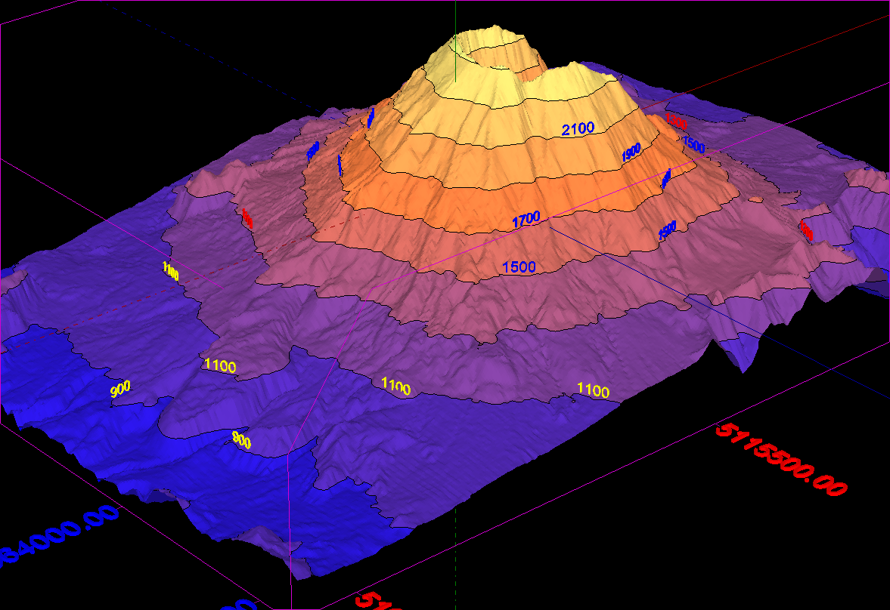
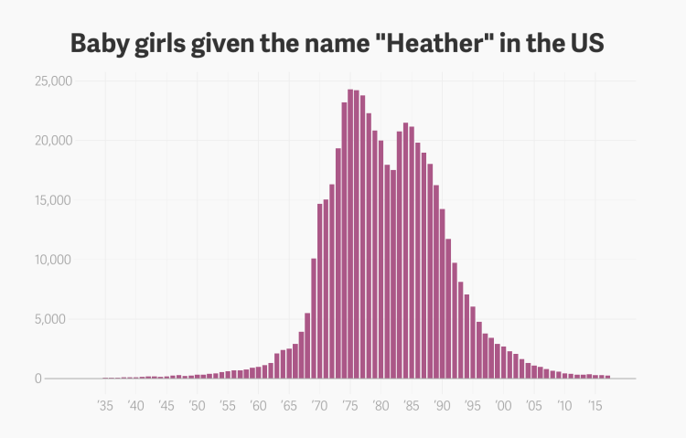
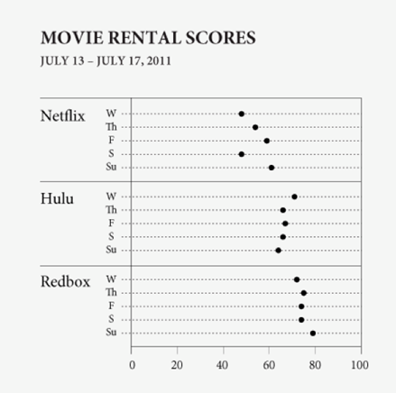
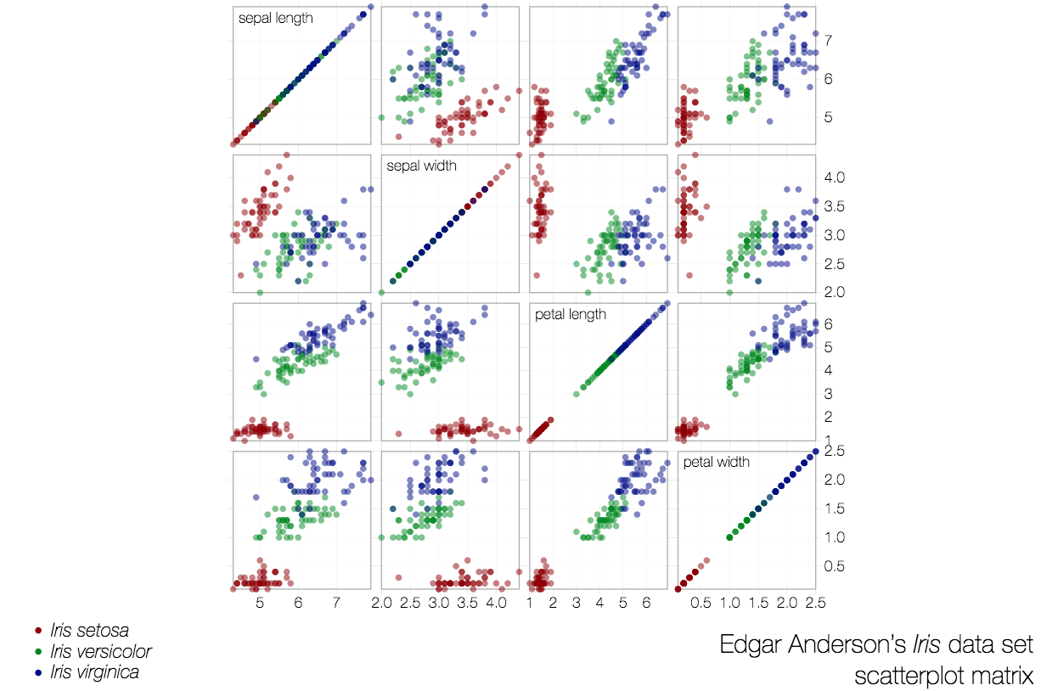
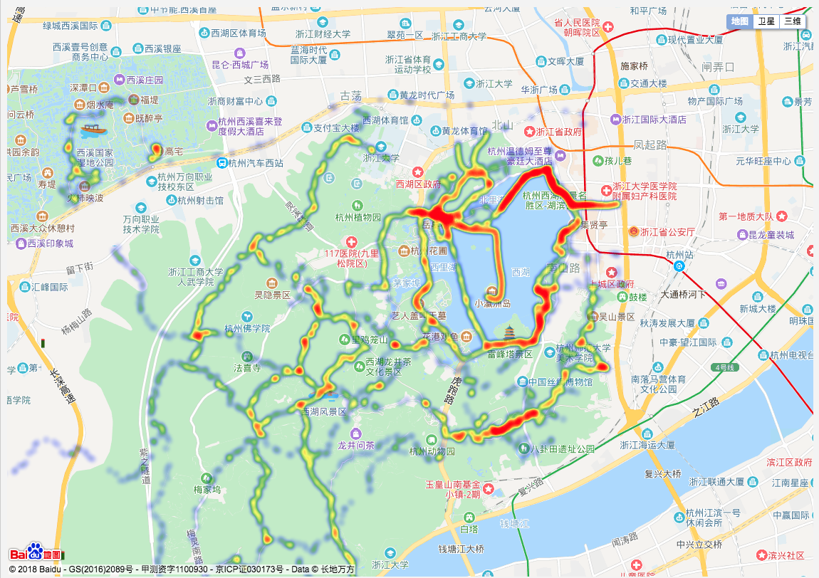
Exploratory Data Analysis (EDA)
Based on statistics
Data visualization-driven method
Summary of main characteristics in easy-to-understand form
Types of data visualization methods in EDA:
Plotting of raw data
Plotting of statistical values
Multiple coordinated views (Dashboard)

Slide 53
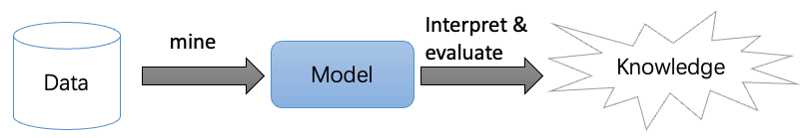
Data Mining
“Data Mining, also popularly referred to as knowledge discovery from data (KDD), is the automated or convenient extraction of patterns representing knowledge implicitly stored or captured in large databases, data warehouses, the Web, other massive repositories, or data streams.”
-- H. Jiawei and M. Kamber, “Data Mining: Concepts and Techniques”, 3rd ed., 2011.

Slide 54
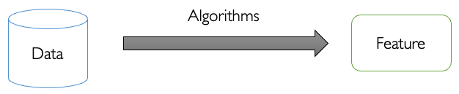
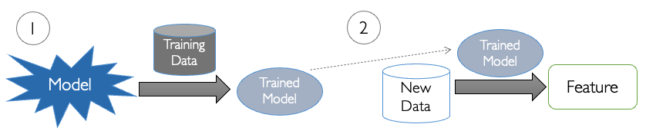
Tasks in Data Mining
Descriptive Tasks
Predictive Tasks

Slide 55
Descriptive Tasks
Concept Description
Describe features of data directly
Association Analysis
Analyze “feature-value” pairs that occur frequently in data
Clustering
Group data on the principle of maximizing the intra-class similarity and minimizing the inter-class similarity
Outlier Detection
Analyze objects that do not comply with the general behavior or model of the data

Slide 56
Predictive Tasks
Regression
Model the relationship between a scalar response and a number of variables
Classification
Find a model/function that describes and distinguish data classes or concepts based on analysis of a set of training data
Evolution Analysis
Analyze temporal and spatial patterns in dataset, model these patterns and predict data in unknown spatio-temporal positions

